Slide 1
The Acoustic Environment

Slide 2
Factors effecting Acoustic Environment
Inverse Square Law: The geometrical spreading of sound from a coherent source is changing in level 6 dB for each doubling of distance.
Attenuation due to atmospheric absorption
Reflection and diffraction around solid objects
Refraction and shadow formation by wind and temperature.
Reflection and absorption by the ground surface itself.

Slide 3
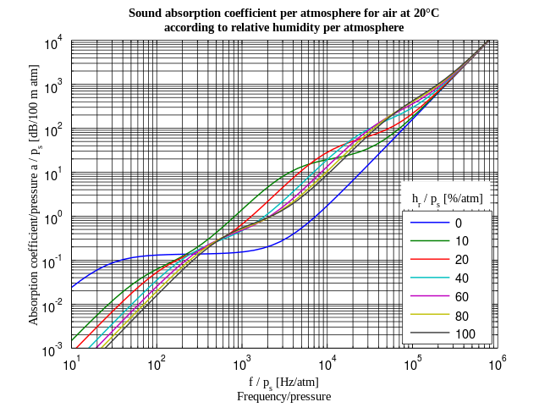
Attenuation due to atmospheric absorption
Due to viscosity and heat conduction
Losses due to a relaxation behavior in the vibrational states of the oxygen molecules in the air→ this behavior strongly depend on the presence of water molecules in the air(absolute humidity).

Slide 4
Temperature Dependent sound velocity
Where
Is the ratio of specific heat
Is the equilibrium gas pressure in Newtons per square meter
Is the density in Kg per cubic meter

Slide 5
The effect of altitude of Velocity of Sound in Air

Slide 6
Doppler Effect
Example: a sound source producing a pure tone of 1kHz approaching to a listener with the velocity of 60 km/h what will be the perceive frequency by the listener.

Slide 7
Reflection and Refraction
Cooler
Warmer
Warmer
Cooler
Wind blowing in the same direction of sound produces temperature gradients along the ground surface that tend to refract the sound downward
Wind blowing against the sound direction produces temperature gradients near the ground surface that tend to refract the sound upward.

Slide 8
Reflection from large boundary when delayed in time relative to the direct sound can highly destructive of speech intelligibility.
2D_{m} + D_{m}
D_{s}
D_{m}
D_{m}
D_{ms}
Reflected signal relative level=

Slide 9
Sound Field
Free Fields
A sound field is said to be a free field if it is uniform, free of boundaries, and is undisturbed by other sources of sound. In practice, it is a field in which the effects of the boundaries are negligible over the region of interest. The flow of sound energy is in one direction only. Anechoic chambers and well-above-the-ground outdoors are free fields.
The direct sound level from a sound source in a free field is labeled L_{D}
Diffuse (Reverberant) Fields
A diffuse or reverberant sound field is one in which the time average of the mean square sound pressure is the same everywhere and the flow of energy in all directions is equally probable. This requires an enclosed space with essentially no acoustic absorption.
The reverberant sound level is labeled L_{R}.

Slide 10
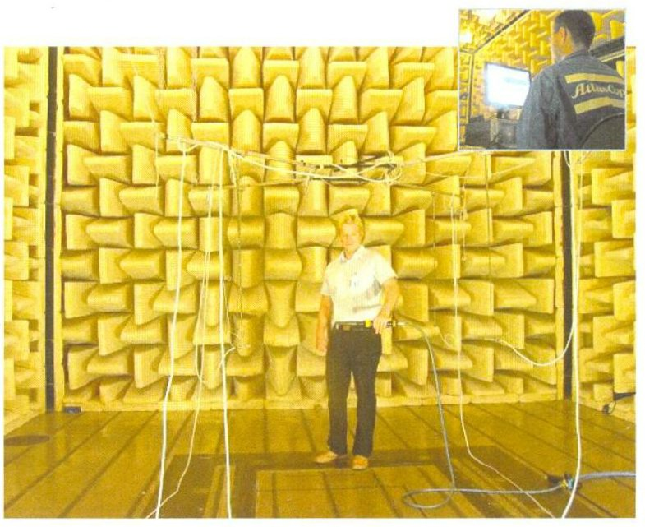
MWL Lab, KTH Sweden
Finding sound power (ISO 3745)

Slide 11
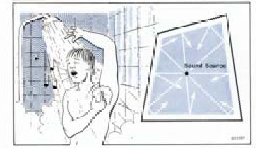

Slide 12
Semi-reverberant Fields
A Semi-reverberant Fields is one in which sound energy in both reflected and absorbed. The flow of energy is in more than one direction
Pressure Field
A Pressure field is one in which the instantaneous pressure is everywhere uniform. There is no direction of propagation. Used for microphone calibration.
Near field
The near field of a source is the region close to a source where the sound pressure and acoustic particle velocity are not in phase. In this region the sound field does not decrease by 6 dB each time the distance from the source is increased
The near field is limited to a distance from the source equal to about a wavelength of sound or equal to three times the largest dimension of the sound source

Slide 13
Far field
The far field of a source begins where the near field ends and extends to infinity. Note that the transition from near to far field is gradual in the transition region. In the far field, the direct field radiated by most machinery sources will decay at the rate of 6 dB each time the distance from the source is doubled.
Ambient Noise field
The ambient noise field is comprised of those sound source not contributing to the desired L_{D .}

Slide 14
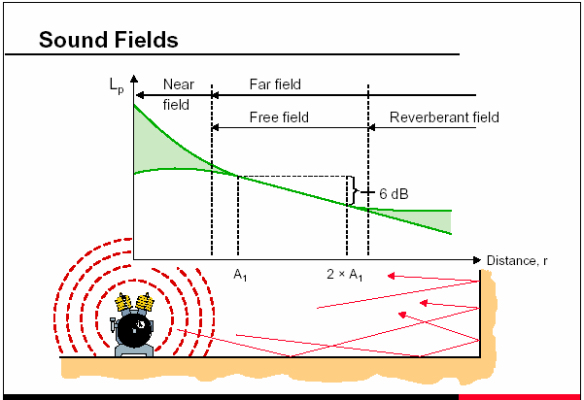

Slide 15
Outdoor Acoustic
The ambient noise level is 70dB and a sound system generate SPL of 110dB at 4ft. How far the sound will travel before it submerged with noise.

